Slide 1
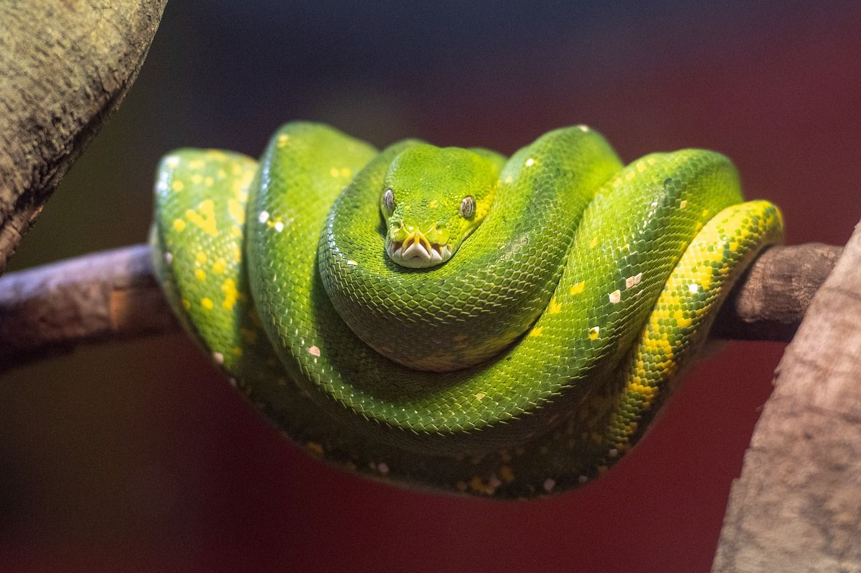
PYTHON
PROJECT
MEMORY
CARD

Slide 2
PYTHON
PROJECT
MEMORY
CARD

Slide 3
WHAT IS IT?
01 This project was written in the "Python" programming language
02 This project is a program of the "Window Applications" type
03 This project is a four-answer test on the topic of "World War II"
04 This project is commissioned, that is, it does not belong to us

Slide 4
WHAT IS IT?
01 This project was written in the "Python" programming language
02 This project is a program of the "Window Applications" type
03 This project is a four-answer test on the topic of "World War II"
04 This project is commissioned, that is, it does not belong to us

Slide 5
WHAT IS IT?
01 This project was written in the "Python" programming language
02 This project is a program of the "Window Applications" type
03 This project is a four-answer test on the topic of "World War II"
04 This project is commissioned, that is, it does not belong to us

Slide 6
WHAT IS IT?
01 This project was written in the "Python" programming language
02 This project is a program of the "Window Applications" type
03 This project is a four-answer test on the topic of "World War II"
04 This project is commissioned, that is, it does not belong to us

Slide 7
WHAT IS IT?
01 This project was written in the "Python" programming language
02 This project is a program of the "Window Applications" type
03 This project is a four-answer test on the topic of "World War II"
04 This project is commissioned, that is, it does not belong to us

Slide 8
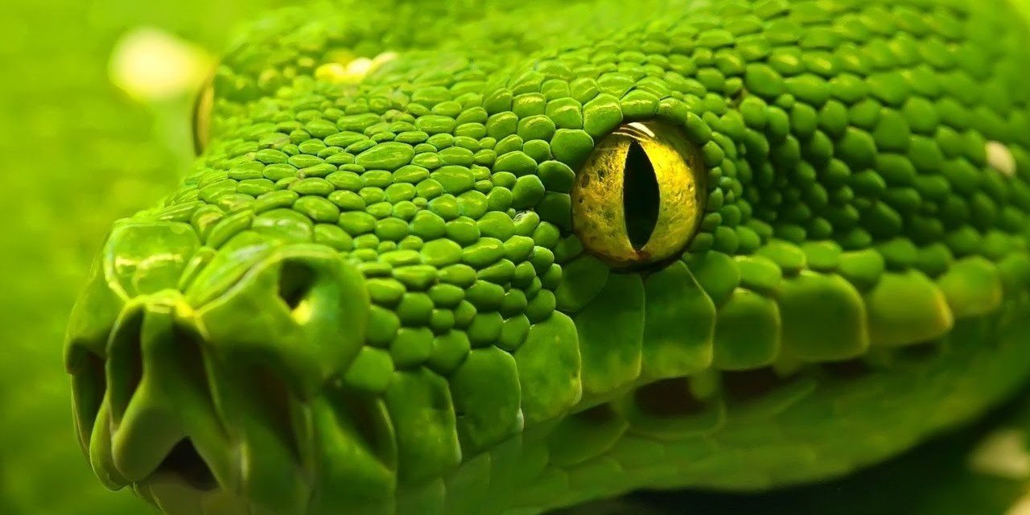
HOW DOES IT WORK?

Slide 9
HOW DOES IT WORK?

Slide 10
HOW DOES IT WORK?

Slide 11
HOW DOES IT WORK?

Slide 12
HOW DOES IT WORK?

Slide 13
WHERE CAN WE USE IT?

Slide 14
WHERE CAN WE USE IT?
IDK BRO

Slide 15
IDK BRO

Slide 16
ONE MORE THING

Slide 17
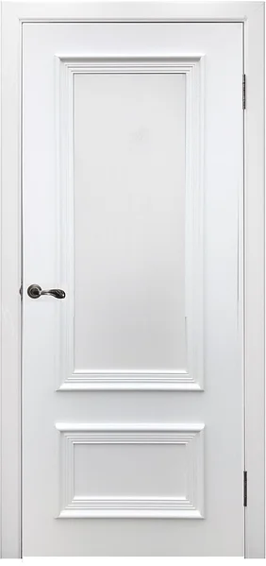
ONE MORE THING

Slide 18
OH, WTF IS THIS?

Slide 19
LET’S SEE

Slide 21
